Slide 1
Designing & Implementing
Data Pipelines for
Scientific Research
Transformations

Slide 2
The scikit-learn pipeline
The pipeline object in scikit-learn is designed to meet the aforementioned desirable properties of pipelines, so it's a good idea to use it when implementing pipelines in python.
Even if you don’t use it, it’s useful to study it and use it as a template when implementing your own pipeline from scratch (or in another language).
A pipeline object in scikit is simply a chain of scikit transformer objects, so let’s define what those are first.
Notes:
The pipeline is dependent on the model. And this makes sense, you might alter your pipeline depending on what model you use.

Slide 3
Transformations in scikit-learn
Transformer objects in scikit are simply objects that transform an input X in some way.
They have three main callable methods:
fit(X, y)
transform(X)
fit_transform(X, y)
Youfirst “calibrate” it with some values according a training dataset using fit, then use the calibrated version to transform another dataset using transform. The fit_transform method, fits and then transforms the data in one call.
Let’s look at an example of a transformation.
Notes:
Question: if there is this

Slide 4
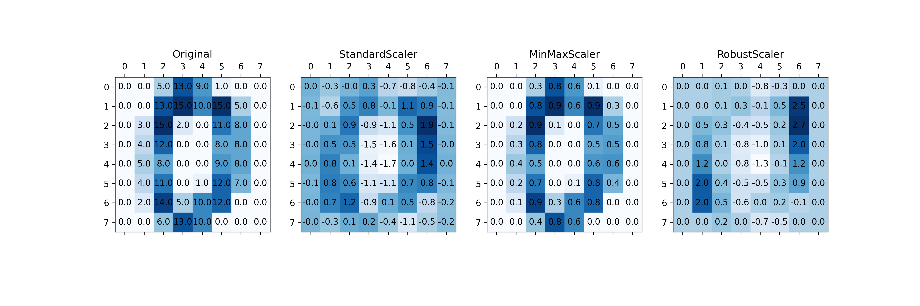
Transformations in scikit-learn
Notes:
This is a method of scaling

Slide 5
Transformations in scikit-learn
This is just one type of transformation, but scikit-learn comes bundled with a bunch of different transformations
The cool thing is that you can also create custom transformations using scikit-learn’s BaseEstimator (which we will see later in one of the labs).
You can define your own fit() and transform() methods.
This means that other people can use only the transformer that you implemented, even if they don’t care about the rest of your pipeline.
There is a well-established scikit-learn ecosystem of custom transformers out there, so it is possible that if you don’t know how to implement it yourself, somebody has already done it!
Notes:
Question: if there is this

Slide 6
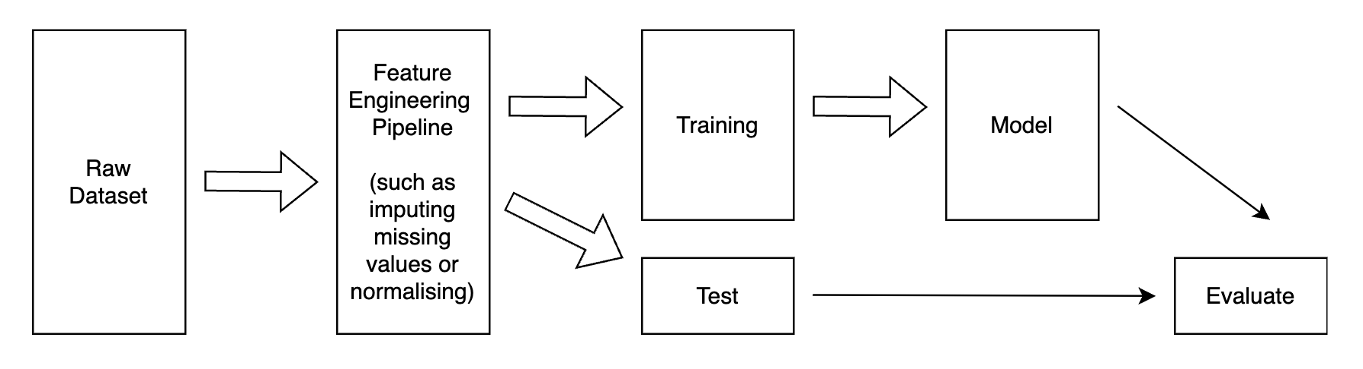
Reproducibility
It is much easier to make code reproducible if we separate the data processing from the model, but this is sometimes difficult to do. Here is example of how improperly separating feature engineering and models can lead to methodological flaws:
What is the problem here?
Notes:
We should try and separate the data processing from the model, but this is sometimes difficult to do. Here is example of how improperly separating feature engineering and models can lead to methodological flaws:

Slide 7
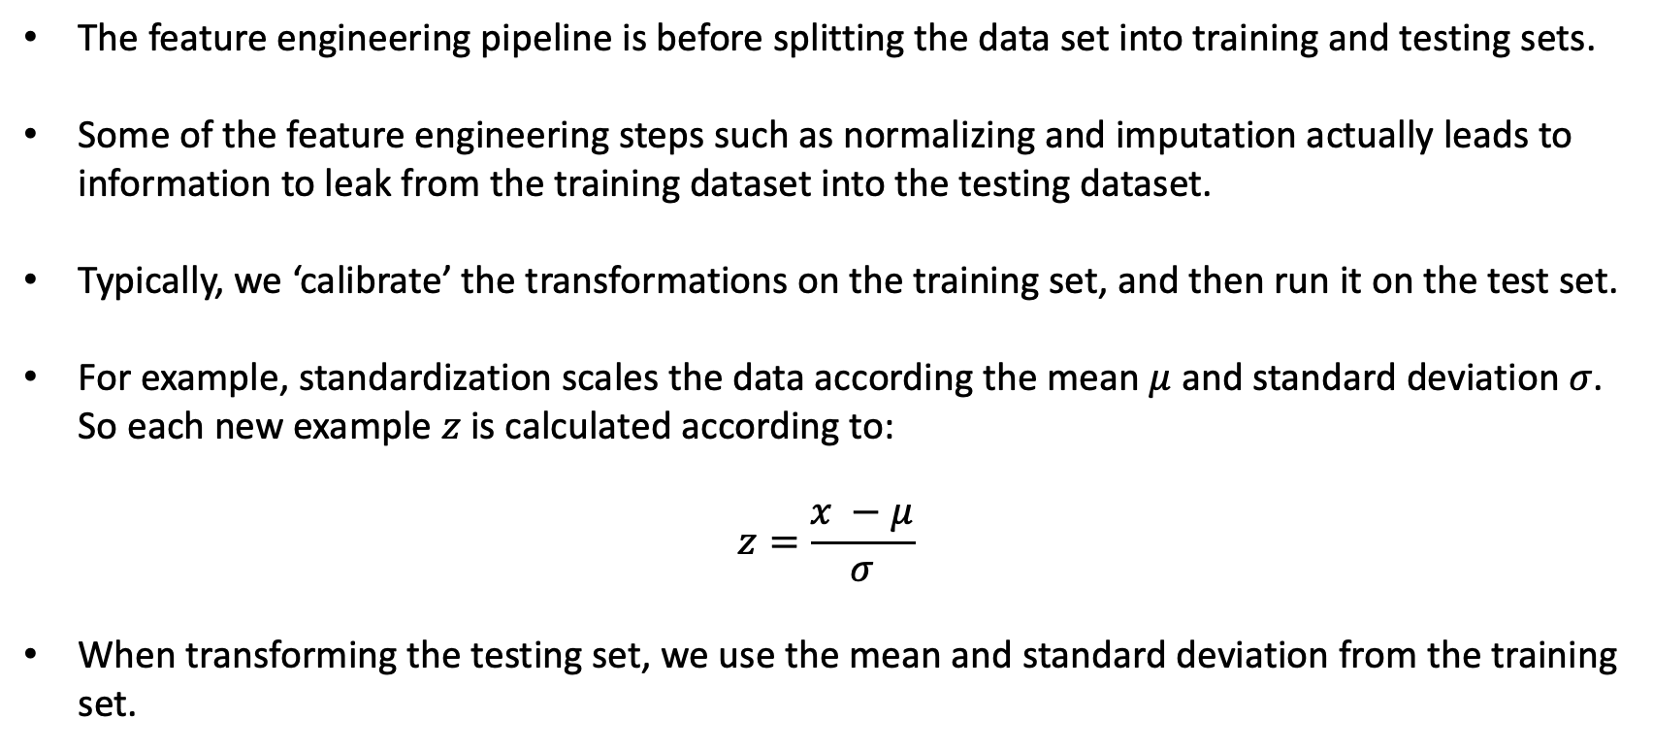
Reproducibility
The feature engineering pipeline is before splitting the data set into training and testing sets.
Some of the feature engineering steps such as normalizing and imputation actually leads to information to leak from the training dataset into the testing dataset.
Typically, we ‘calibrate’ the transformations on the training set, and then run it on the test set.
For example, standardization scales the data according the mean $μ$ and standard deviation $σ$. So each new example $z$ is calculated according to:
$$z=\frac{x −μ}{σ}$$
When transforming the testing set, we use the mean and standard deviation from the training set.
Notes:
Why are we bothering to do all this? We want reproducibility. Multiple fields are battling through a replication crisis right now, and it’s not unique to social sciences. Physics and computer science also have these issues. Papers published at big conferences like ICML, Neurips, ICLR, sometimes have questionable peer review processes.
I like to draw a comparison between running a formula one team. You’re the boss of a formula one team. Every single thing your drivers do in the car is monitored. Heart rate, breathing rate, location on track, speed on the straight, speed though every part of every corner, steering angle, throttle input, brake input, lateral and longitudinal G-forces. Everything is collected and compared to the driver on the other side of the garage. So if you’re driver is slow, everyone knows about it, there is nowhere to hide. And we should take this driver, and use this information to make them better, faster. And if they can’t we can just get someone else who can do the job. The driver is your code. Your code needs to be open to scrutiny so that the peer review process can function effectively. Back in the 50s and 60s, you get in the car and you just try and be quicker than everyone else over a single lap.

Slide 8
Transformations in PyTorch
Transforming your data in PyTorch is done using the the transforms module from torchvision and torchaudio.
Just like sklearn, they offer some prepackaged transformations:
GaussianBlur
Normalize
RandomVerticalFlip
MelSpectrogram
Just like in sklearn, you can also create your own custom PyTorch transformations.
In both Scikit-learn and PyTorch, it is straightforward to string multiple transformations one after the other. We will see how to do this in the lab using two examples: the digits we saw, and some text data.
Notes:
PyTorch is not a general purpose machine learning library like sklearn. It is geared primarily towards Neural Networks.

